Slide 1

Price Bundle
Mockup User Requirement Specification (URS)

Slide 2

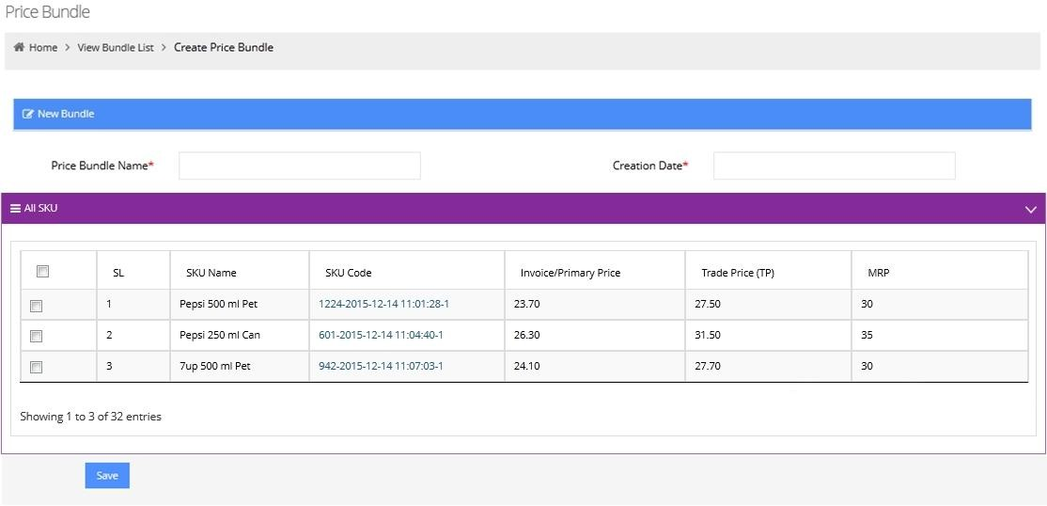

Price Bundle Creation
Actor
HO
In order to create Price Bundle, Responsible user of HO click on create Price Bundle menu and get all SKU list, where s/he will
input Price Bundle
Invoice price, TP,
Name,
MRP.
Thenafter,
save button.
user will click on

Slide 3
TBL-PB | Version 0.1
Price Bundle Creation – Field Level Specification
SL No | Field Name | Specification
1 | Price Bundle Name | Input Manually
2 | Creation Date | System automatically create Date & time at the time of creation
3 | Invoice Price | Manual Value input
4 | Trade Price | Manual Value input
5 | MRP | Manual Value input.

Slide 4

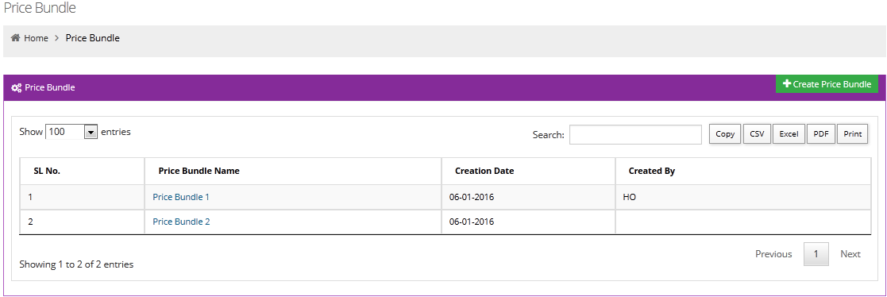
Price Bundle
HO

Slide 5
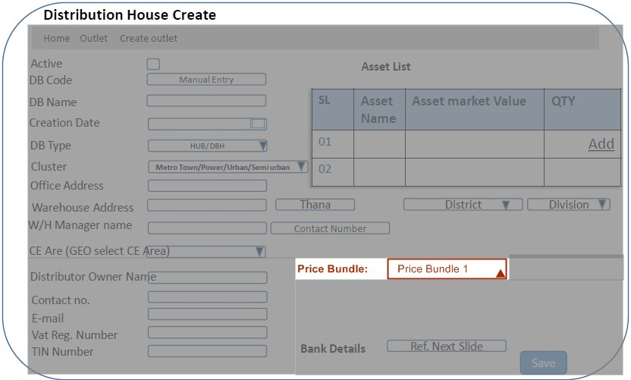
Price Bundle tag with DB
TBL-PB | Version 0.1
Actor
HO
At the time of DB creation, responsible user of HO will select Price Bundle for respective DB from drop down.

